Slide 1

Presented By Eragam Reddy Vishnu Vardhan Reddy
BANK CUSTOMER
SEGMENTATION

Slide 2
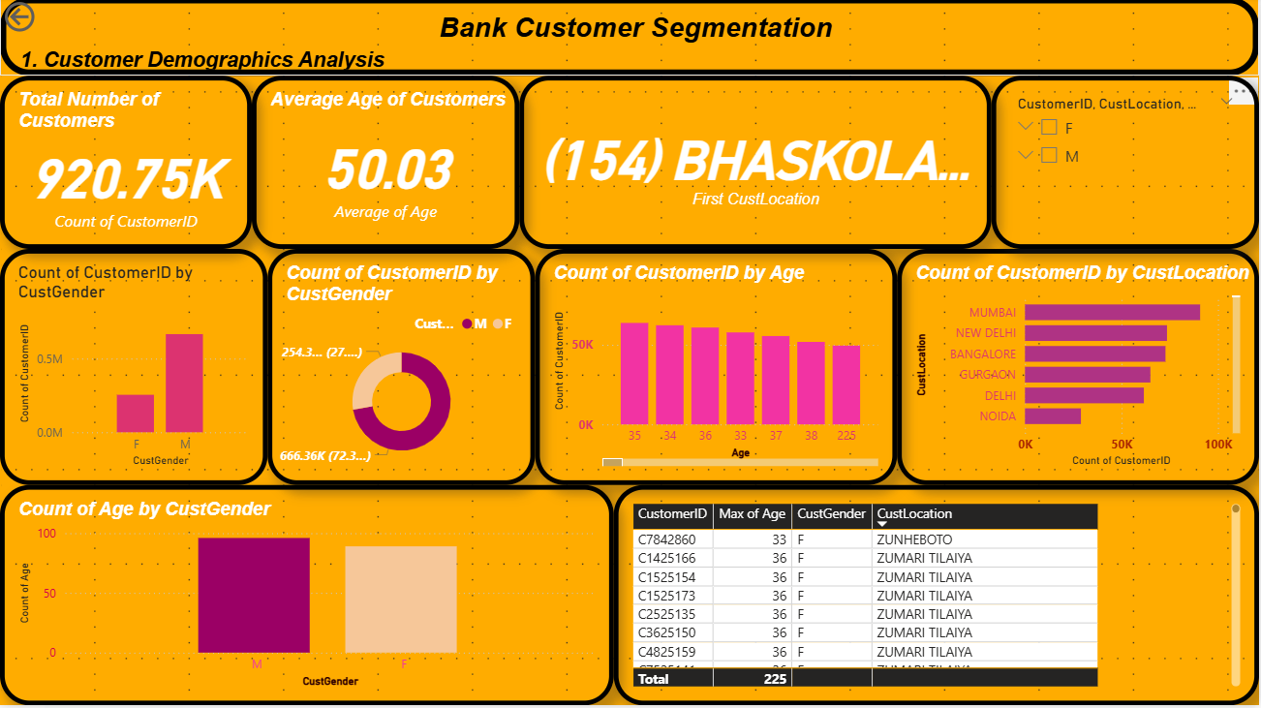

Slide 3
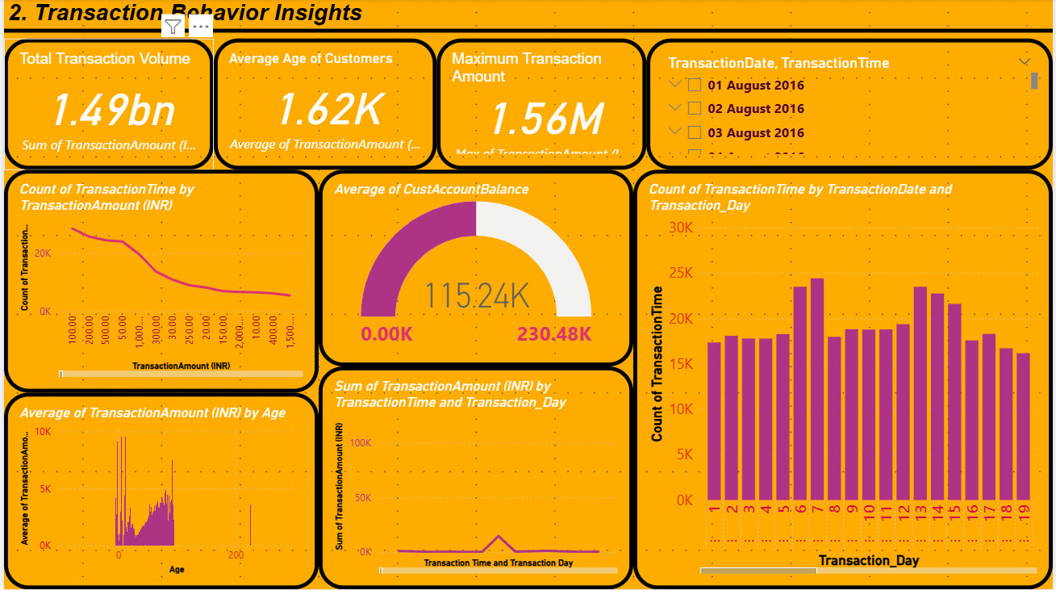

Slide 4
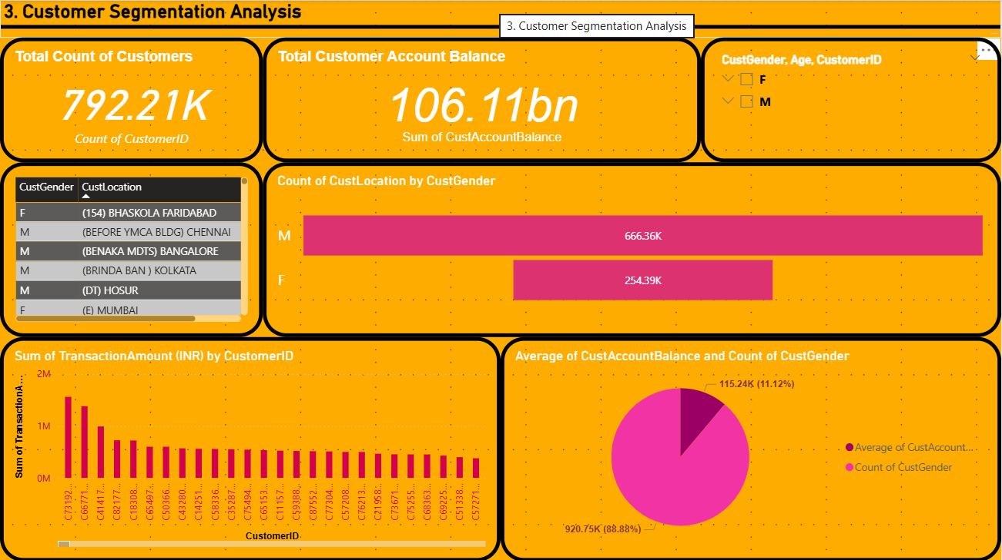

Slide 5

THANK YOU

